Slide 1
Farmer’s Tech Toolbox-Crop Recommendation Disease Detection

Slide 2
Abstract
The "Farmer's Tech Toolbox" project leverages machine learning to provide a web-based platform for crop recommendation and plant disease detection. Utilizing Random Forest for crop selection (99.31% accuracy) and EfficientNetV2 for disease identification (96.06% accuracy), it empowers farmers with data-driven decision-making tools. Future work includes integrating advanced models, expanding datasets, and improving deployment scalability for sustainable agriculture.

Slide 3
Introduction
Agriculture is vital to the global economy, serving as the primary source of food and livelihood for millions worldwide. However, challenges like climate change, resource scarcity, and population growth demand innovative solutions to enhance productivity and sustainability. Traditional farming practices often rely on guesswork, leading to suboptimal crop selection and delayed disease management.
The Farmer’s Tech Toolbox addresses these issues by offering a user-friendly application that uses machine learning for crop recommendations and image processing for disease detection. This tool bridges the gap between traditional methods and modern technologies, empowering farmers with actionable insights for better yields and sustainability.

Slide 4
Existing System
Existing systems for crop recommendation and disease detection primarily rely on machine learning and computer vision techniques but often focus on either crop recommendation or disease detection, lacking an integrated approach. Tools like Plantix and Farmers' Friend use image recognition for disease identification, while platforms like Krishi Kisan provide crop recommendations based on soil and climate data.
However, these tools are limited in scope, precision, and adaptability to local conditions. Many depend on predefined datasets, making them less effective for emerging diseases or diverse agricultural regions. This highlights the need for a comprehensive, scalable solution addressing both functionalities together.

Slide 5
Proposed System
The proposed system, Farmer’s Tech Toolbox, integrates machine learning and image processing to provide farmers with crop recommendations and plant disease detection in a unified platform. It analyzes soil properties, weather data, and historical crop performance using advanced ML algorithms like Random Forest for crop selection. For disease detection, Convolutional Neural Networks (CNNs) such as EfficientNetV2 ensure accurate identification from plant images.
The system features a user-friendly web interface, accessible via mobile and desktop, to empower farmers with actionable insights. Regular updates and future enhancements like IoT integration will improve system adaptability and precision.

Slide 6
LITERATURE REVIEW
The crop recommendation and plant disease detection using machine learning and deep learning techniques. Studies have shown the effectiveness of algorithms like Random Forest and CNNs in analyzing soil, weather, and image data for agricultural decision-making. Tools like Plantix and Krishi Kisan offer specialized functionalities but lack an integrated approach.
Precision agriculture systems using IoT and geospatial analysis have improved efficiency but remain inaccessible to many due to high costs. This underscores the need for a scalable, affordable system combining crop recommendation and disease detection tailored to diverse regions.

Slide 7
Module
Logistic Regression
Decision Tree
Support Vector Machine (SVM)
Multi-Layer Perceptron (MLP)
Random Forest
NumPy
Python with Flask Framework
Matplotlib
Convolutional Neural Networks (CNNs)

Slide 8
Logistic Regression
A classification algorithm that uses a sigmoid function to predict the probability of target classes. It is widely used for binary and multi-class classification problems in structured data.
Decision Tree
A tree-like model that splits data based on feature conditions to make predictions, ensuring interpretability and handling non-linear relationships effectively.
Support Vector Machine (SVM)
A supervised learning algorithm that classifies data by finding the optimal hyperplane separating different classes in high-dimensional space.
Multi-Layer Perceptron (MLP)
A type of feedforward neural network consisting of multiple layers of neurons, used for classification and regression by learning complex patterns in data.

Slide 9
Random Forest
An ensemble learning method that combines multiple decision trees to improve classification accuracy and reduce overfitting, achieving high performance in complex datasets.
NumPy
A Python library for numerical computing, enabling efficient manipulation of large multi-dimensional arrays and matrices, along with a collection of mathematical functions.
Python with Flask Framework
A lightweight web framework for Python, Flask is used to build scalable and user-friendly web applications with integrated back-end functionality.
Matplotlib
A plotting library in Python for creating static, interactive, and animated visualizations, widely used for data analysis and reporting.
Convolutional Neural Networks (CNNs)
Deep learning architectures designed for image processing tasks, capable of detecting spatial hierarchies and features in images for classification or object detection.

Slide 10
Software Components:
Python
Flask Framework
TensorFlow and Keras
HTML, CSS, JavaScript
Matplotlib
NumPy
Pandas
Anaconda
Hardware Components:
Camera/Camera Module
GPU (Graphics Processing Unit)
CPU (Central Processing Unit)
RAM (Random Access Memory)
Storage
Edge Device (Optional)
Power Supply

Slide 11
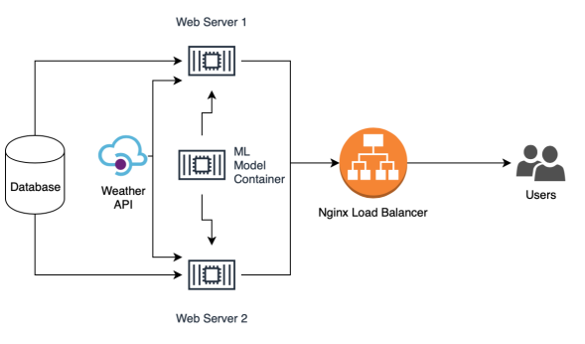
Block Diagram

Slide 12
UML Diagrams
Use Case Diagram
Data Flow Diagram
Sequence Diagram
State Diagram

Slide 13
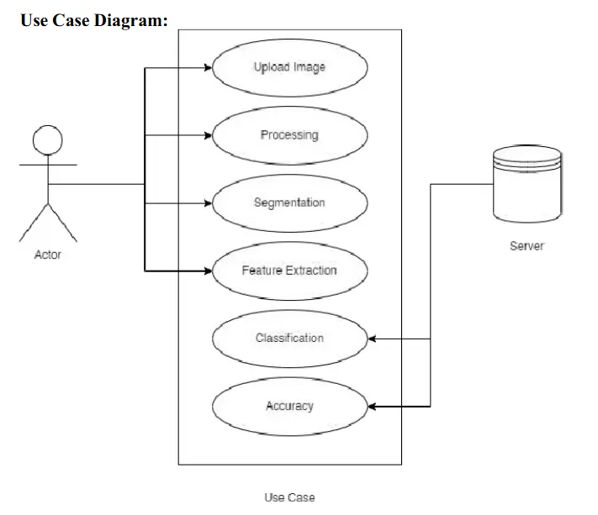
Usecase Diagrams

Slide 14
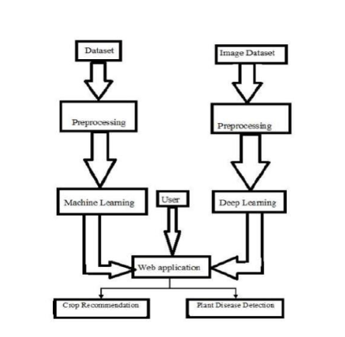
Data Flow Diagrams

Slide 15
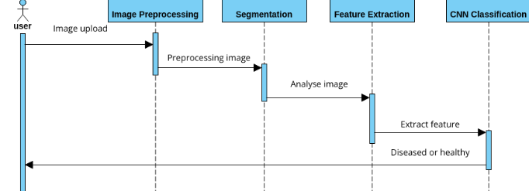
Sequance Diagrams

Slide 16
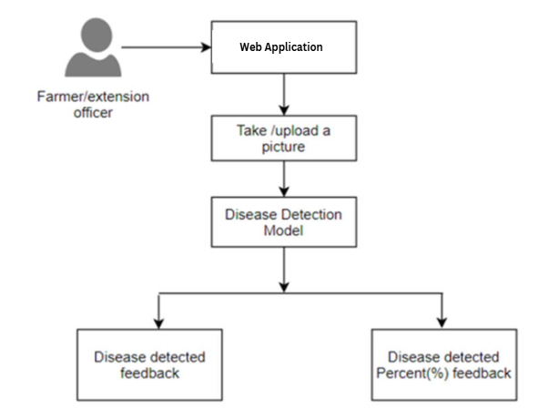
Active Diagrams

Slide 17
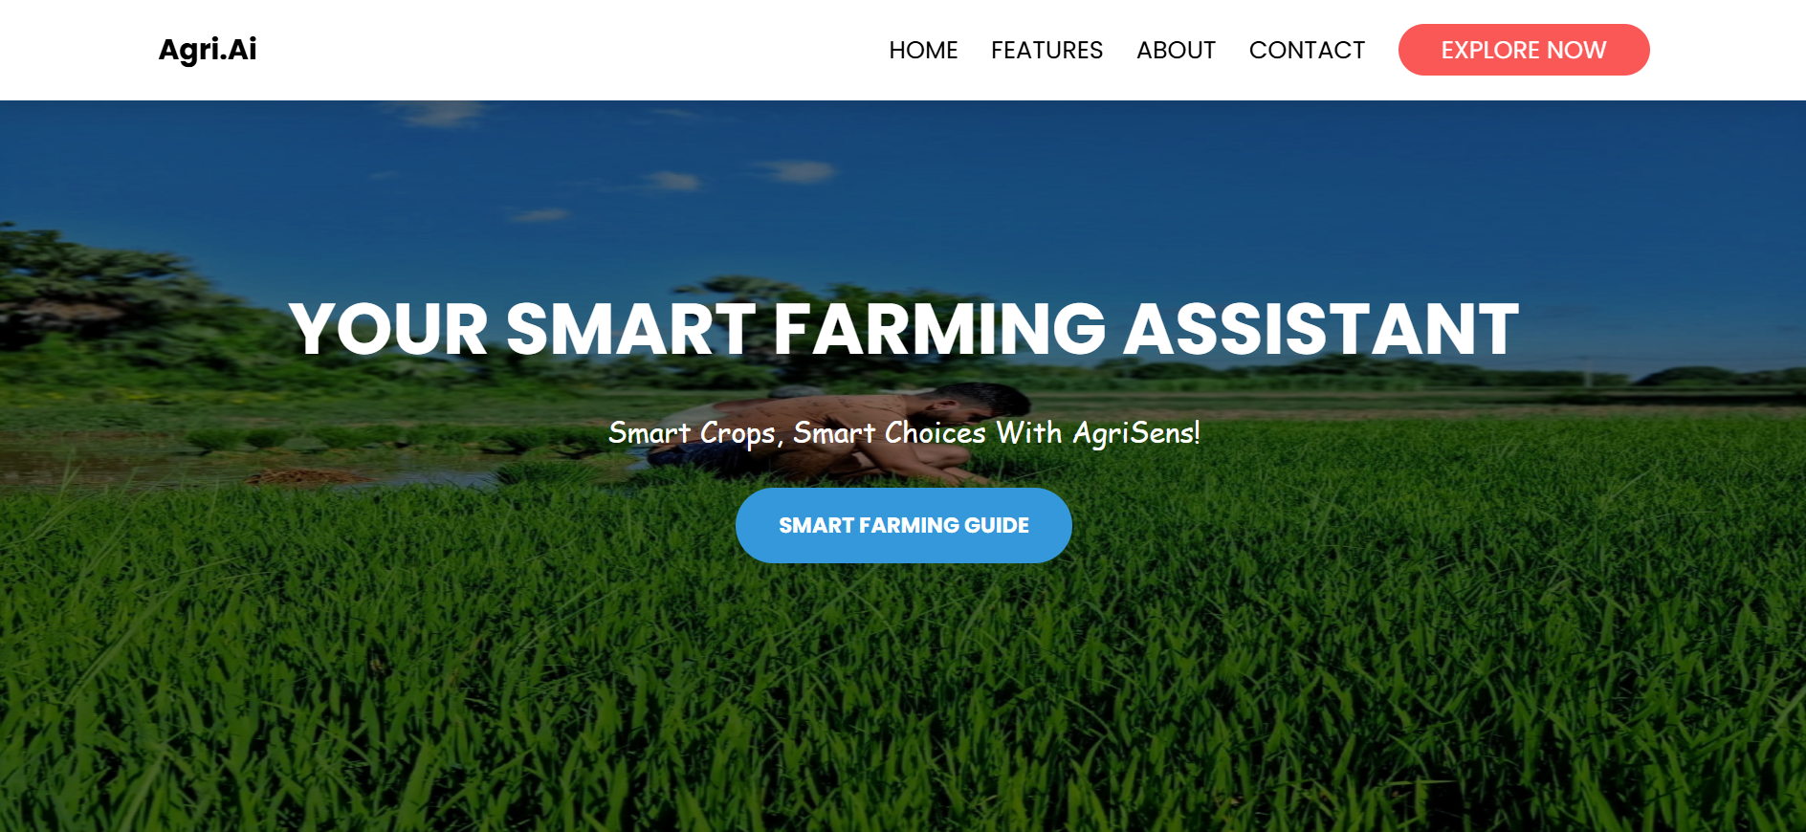
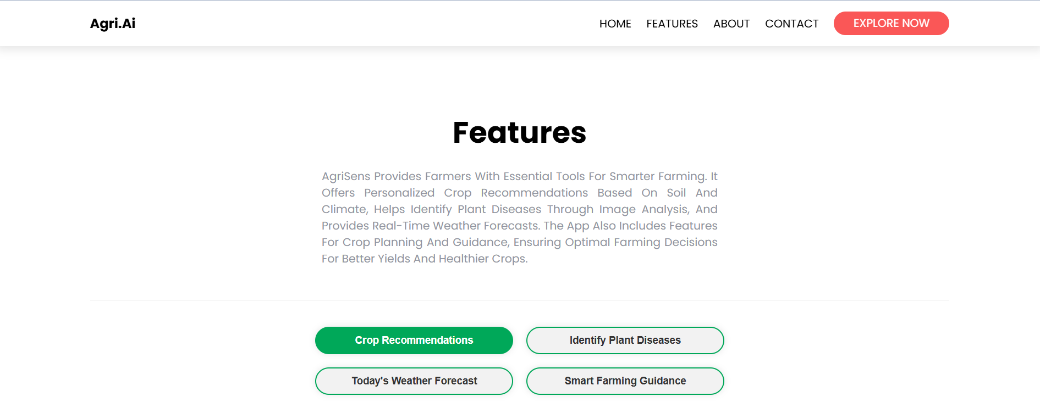
Final Output
the Farmer's Tech Toolbox includes crop recommendations tailored to soil and weather conditions, and accurate disease detection results based on uploaded plant images. It provides actionable insights like suitable crops, disease classifications, and treatment suggestions, displayed through a user-friendly interface.

Slide 18
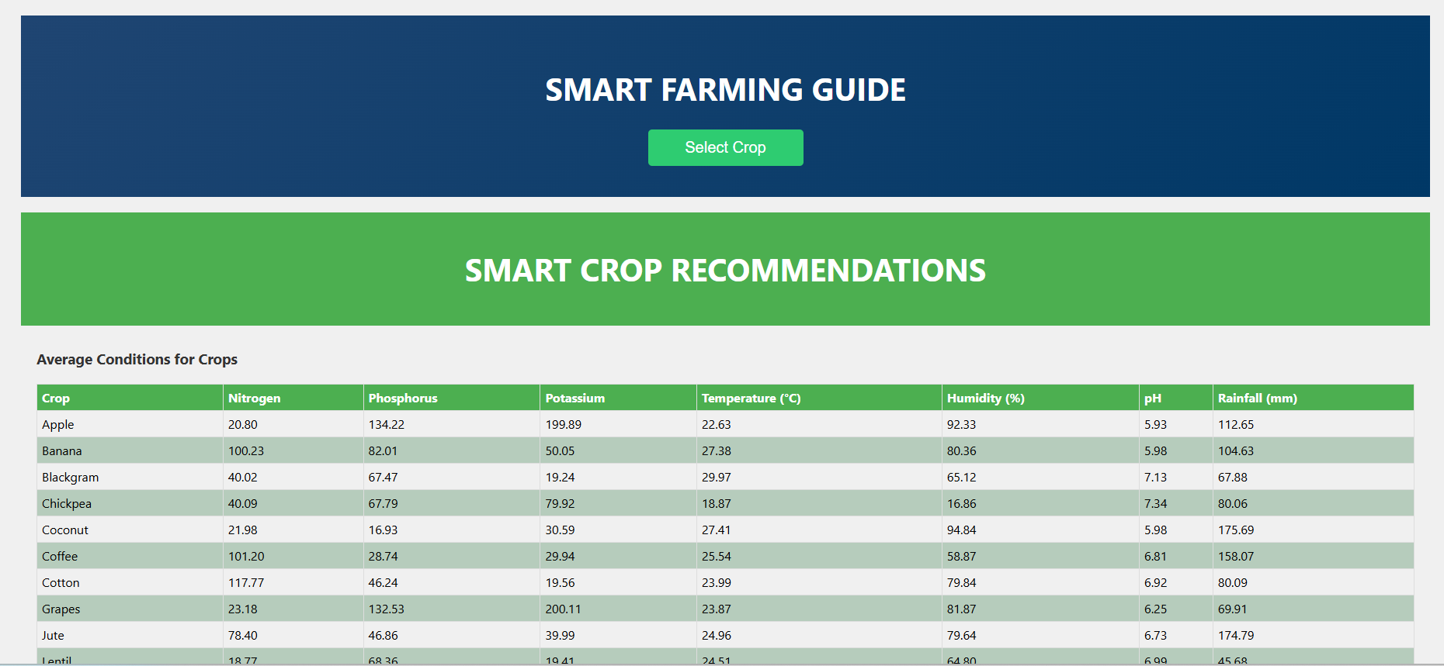
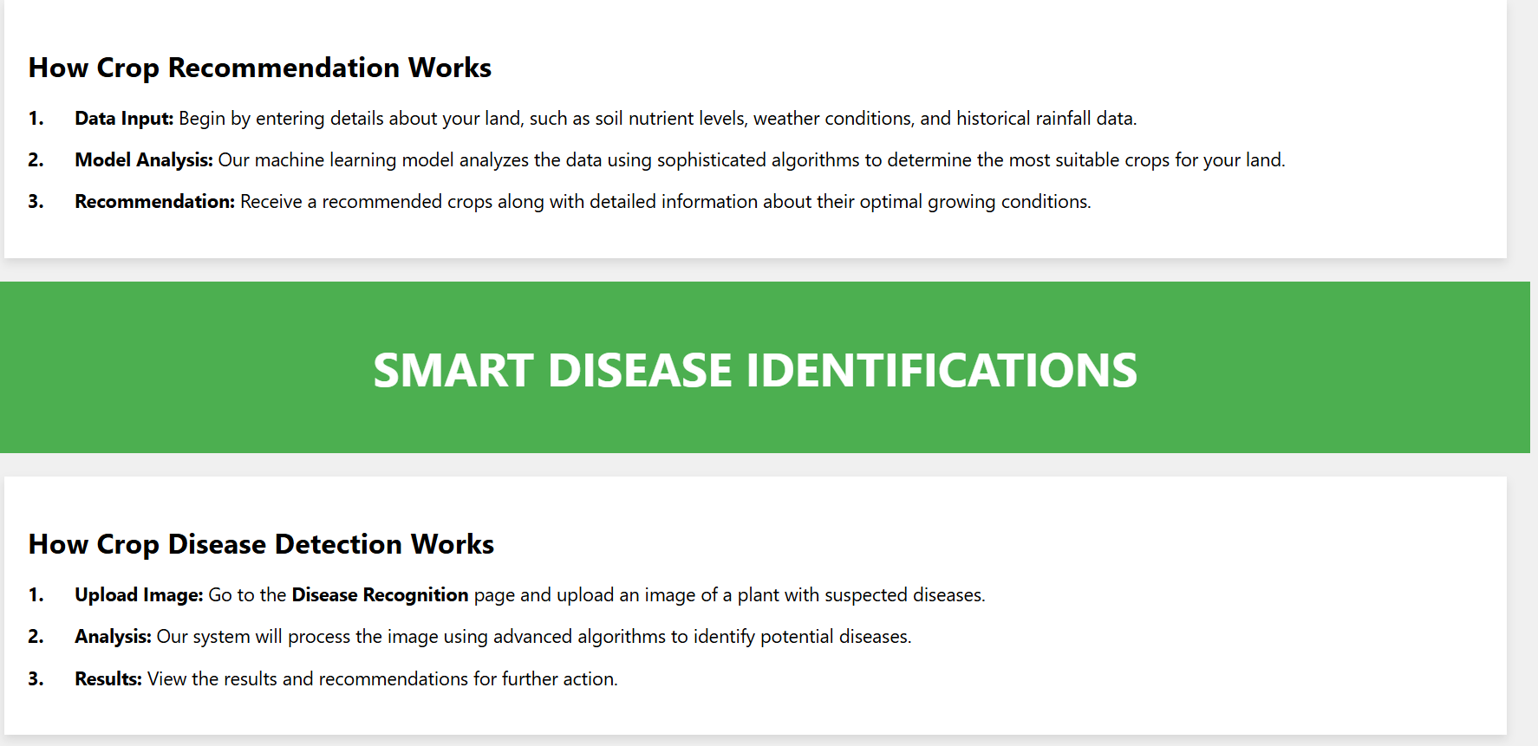
Final Output
Farming Guide

Slide 19
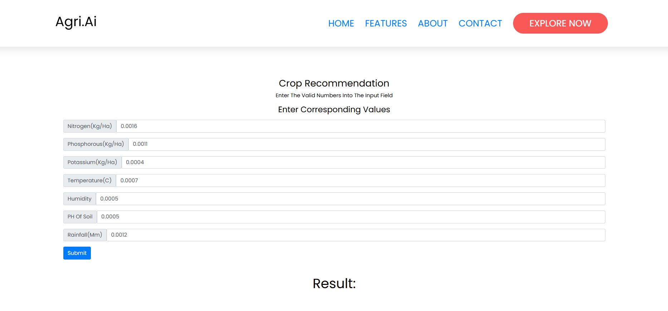
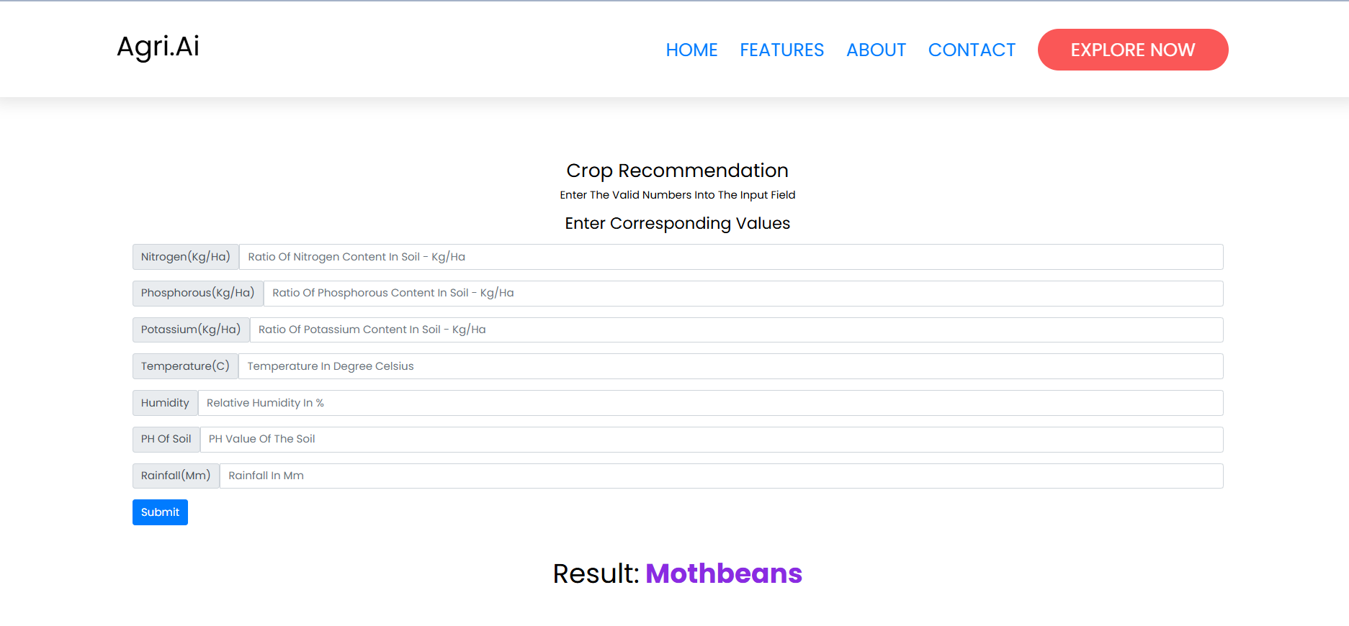
Final Output
Crop Recommendation

Slide 20
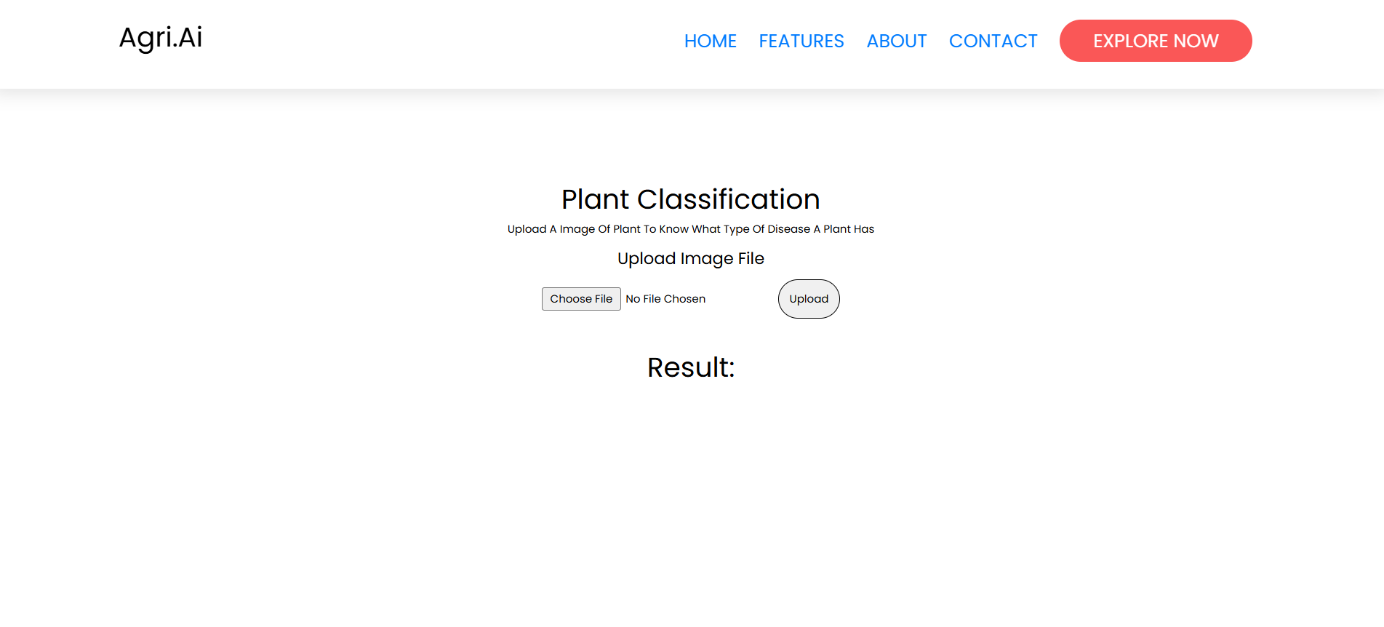
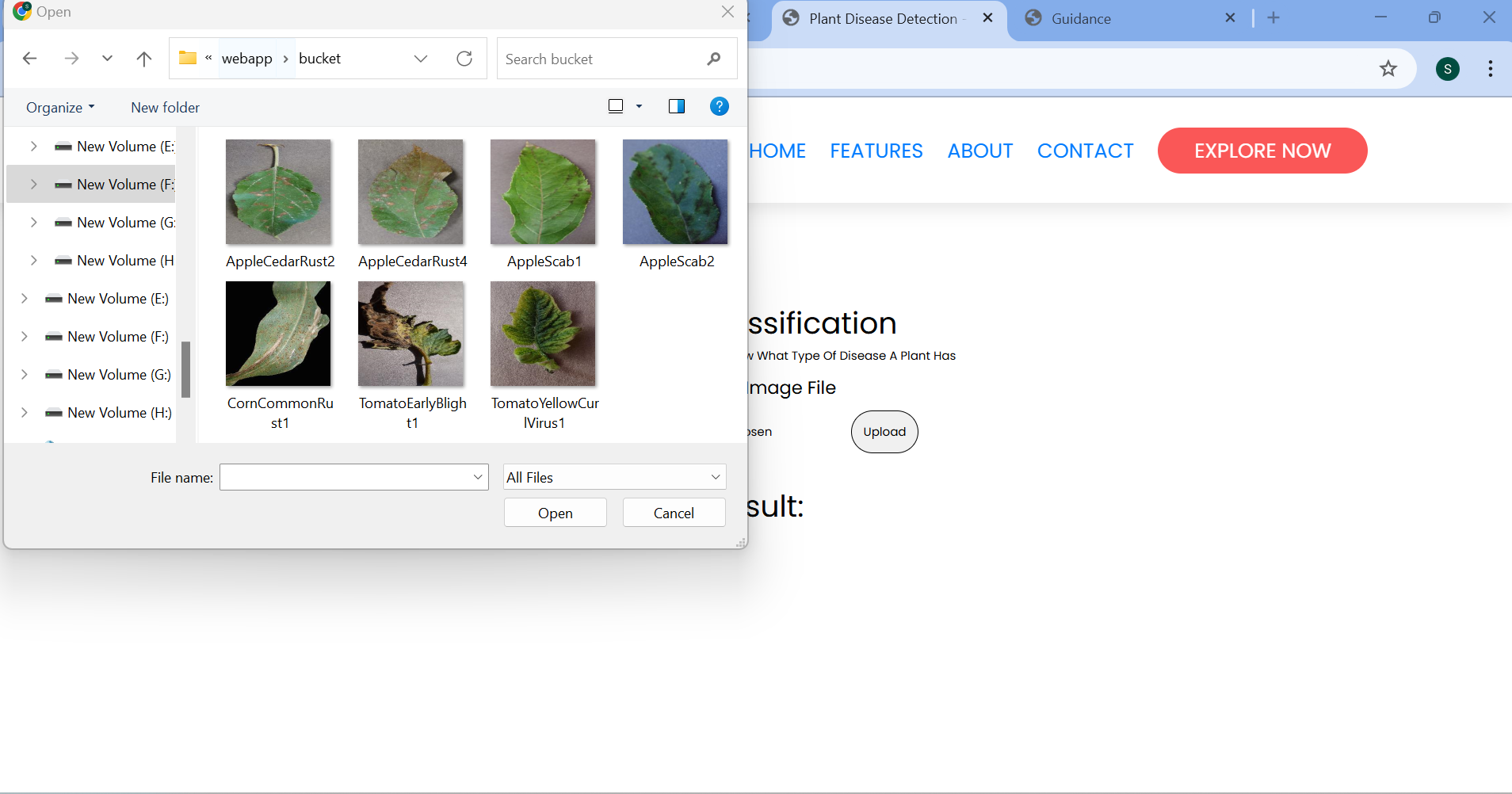
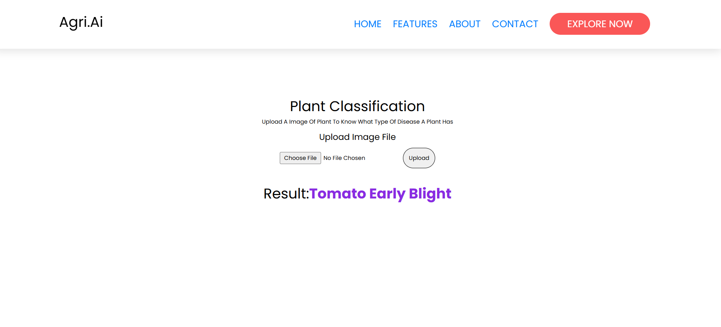
Final Output
Plan Classification

Slide 21
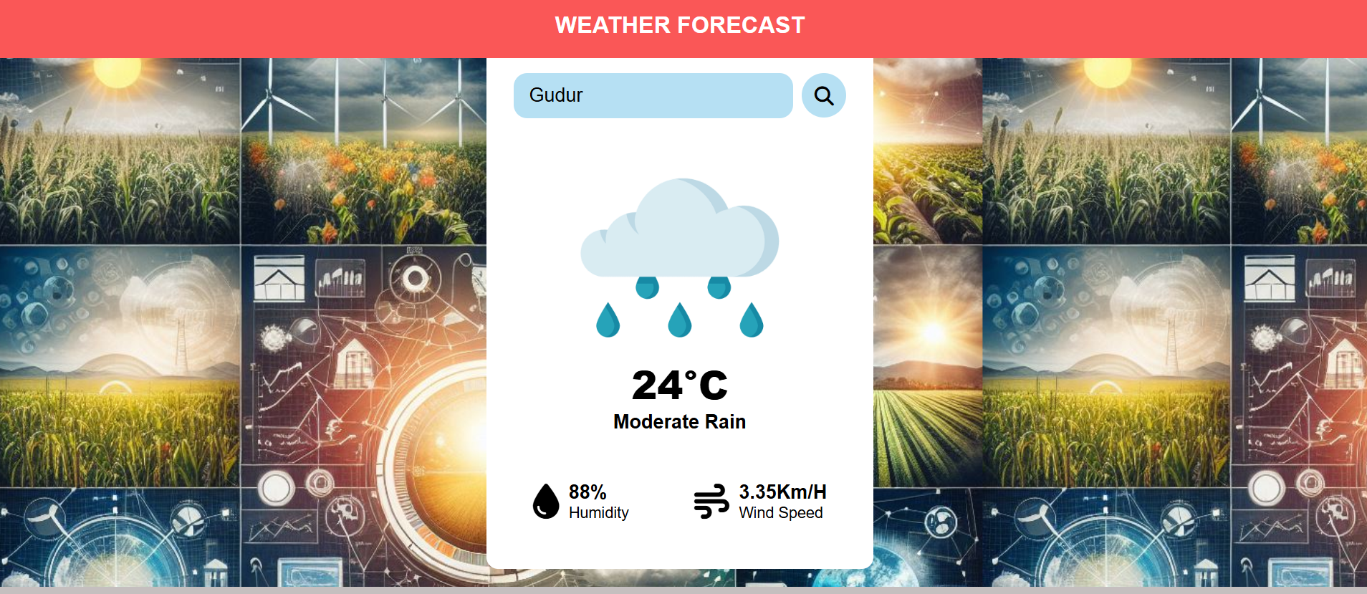
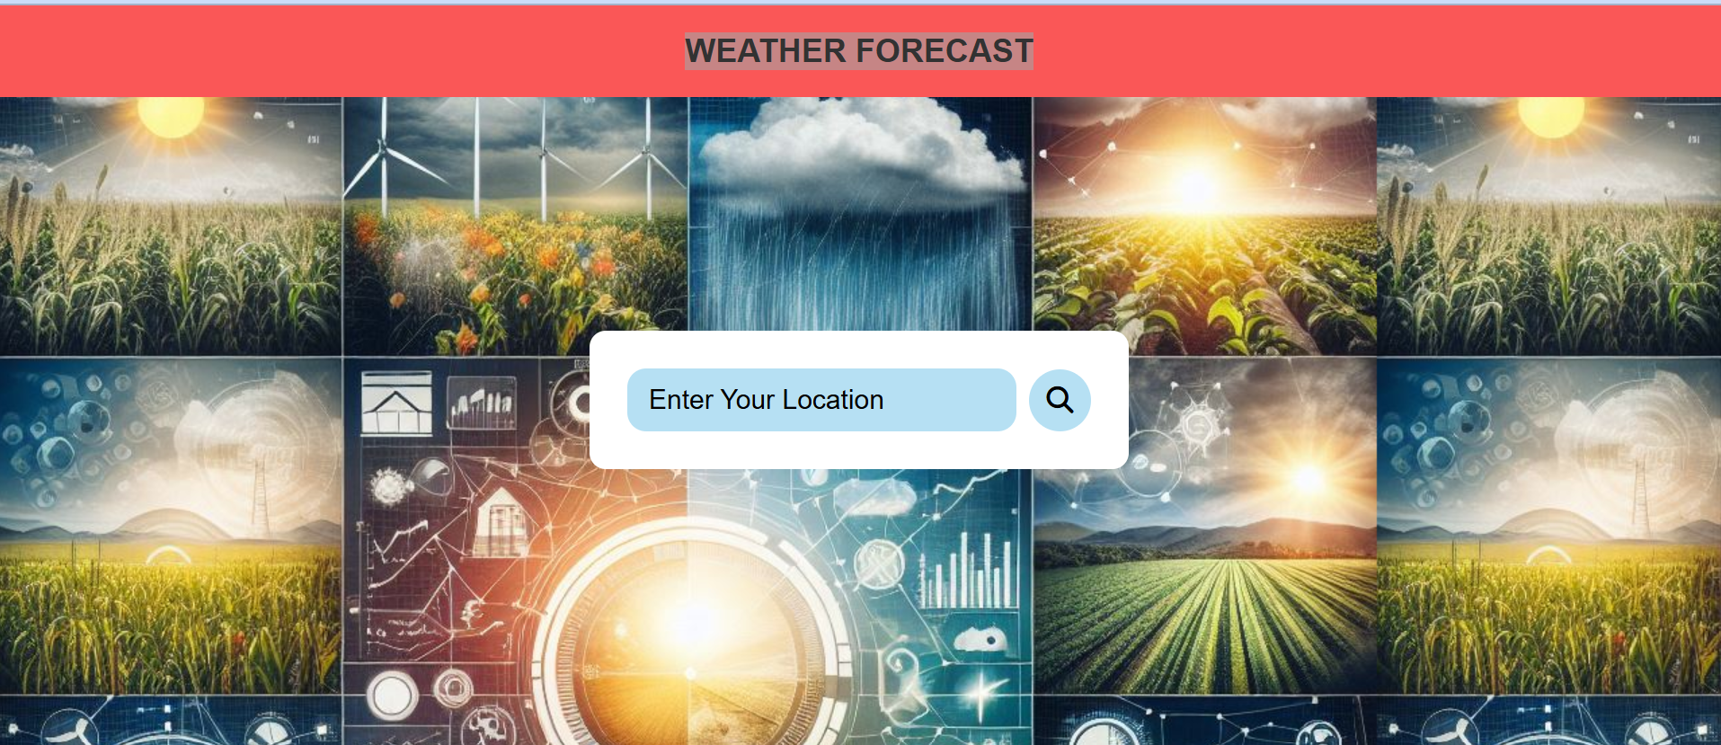
Final Output
Weather Forcasting

Slide 22
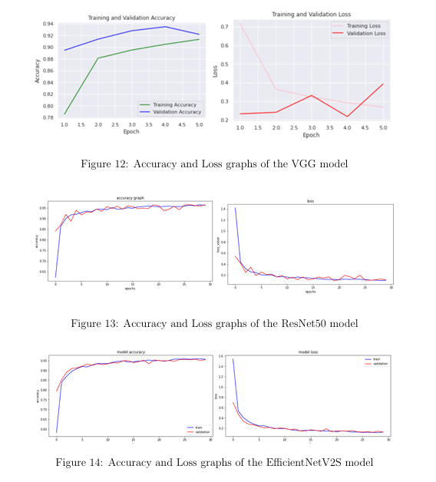
Final Output

Slide 23
Conclusion
The Farmer’s Tech Toolbox project aimed to develop an innovative solution to assist farmers in making informed decisions regarding crop selection and disease management. By leveraging advanced technologies such as machine learning and image processing, the project addresses critical challenges in agriculture, ultimately striving to enhance productivity and sustainability.

